Slide 1
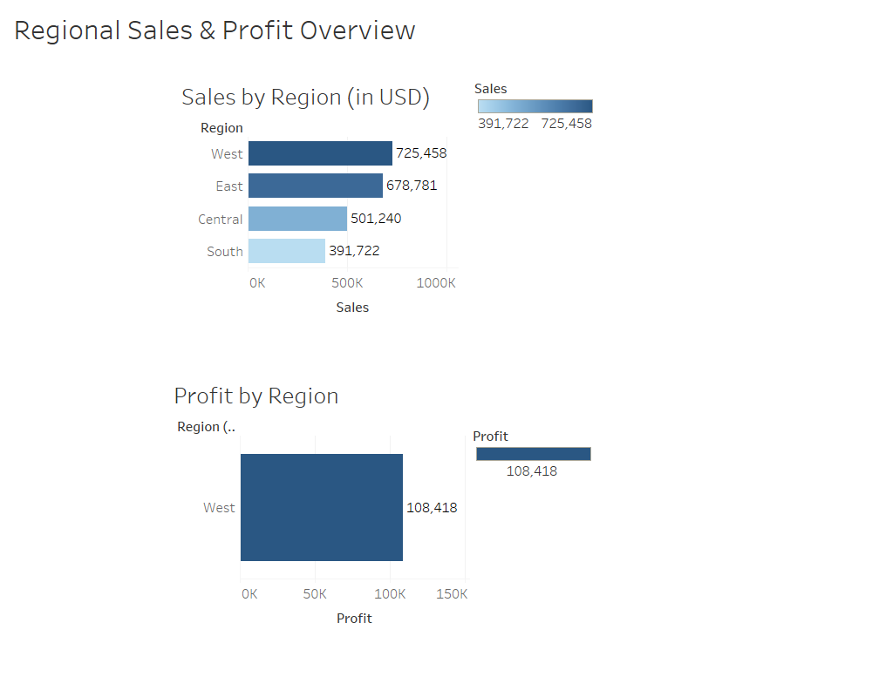
Vishwa Patel

Slide 2
• The West region has the highest sales ($725,458) and highest profit ($108,418).
• The South region lags behind in both sales and profit, needing strategy improvement.
• Visual charts clearly highlight performance gaps across regions
• Data helps guide decisions in supply chain and marketing focus.

